Slide 1


HI6040 (Artificial Intelligence and Machine Learning)
Dr. Farshid Keivanian

Slide 2
Getting Started with Python Scripts in Azure Machine Learning
Objective
Students will run their first Python scripts in the cloud using Azure Machine Learning. The focus is not on building a model but on understanding AzureML's interface, compute setup, and script execution.
If AzureML is not working, Anaconda (for beginners) and VS Code (for those with some background) are alternative options.
Your Password to connect WiFi is your Holmes webmail password, or HiDD/MM/YYYY

Slide 3
Getting Started with Python Scripts in Azure Machine Learning
pip install azure-identity simply adds Microsoft’s Azure Identity library to your Python environment.
It gives your Python code the ability to log in to Azure services by providing different ways to authenticate, such as:
Using your Azure account sign-in from the Azure CLI (az login)
Using credentials stored in Visual Studio Code
Using environment variables (username/password, client ID, tenant ID)
Using Managed Identity if your code is running inside Azure (like on an Azure VM or Web App)

Slide 4
Getting Started with Python Scripts in Azure Machine Learning
Why it’s needed here:
When you use azure.ai.ml to connect to an Azure ML Workspace:
from azure.identity import DefaultAzureCredential
this DefaultAzureCredential comes from azure-identity. It tries several login methods in order (CLI, VS Code, environment, etc.) until it finds one that works.
Without azure-identity, your code can’t sign in to Azure at all — so you can only run local code, not submit jobs to Azure services.

Slide 5
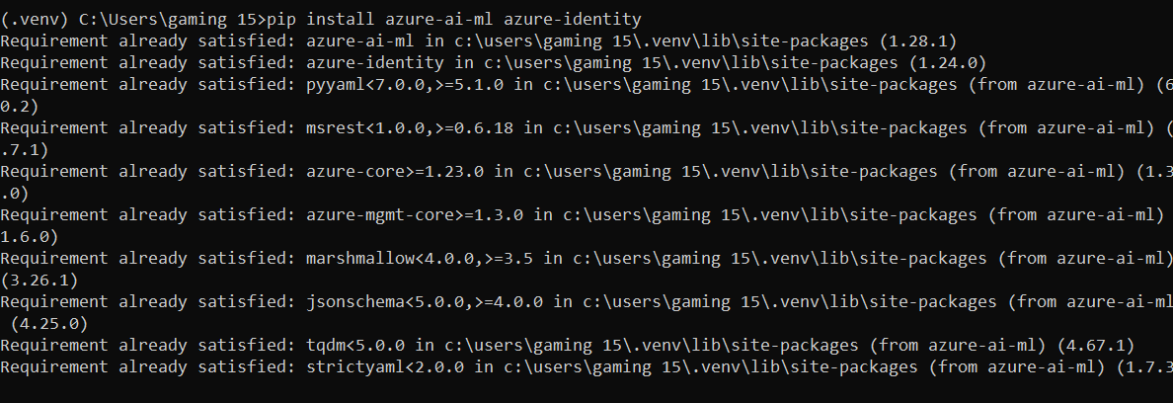
Getting Started with Python Scripts in Azure Machine Learning
pip install azure-ai-ml azure-identity means you are installing two packages at the same time:

Slide 6
Getting Started with Python Scripts in Azure Machine Learning
pip install azure-ai-ml azure-identity means you are installing two packages at the same time:
azure-ai-ml
This is the Azure Machine Learning SDK v2.
It gives Python the ability to create, manage, and run ML workflows on Azure ML.
Includes functions to:
Connect to your Azure ML Workspace
Create datasets, environments, and compute clusters
Submit and monitor training jobs
Register and deploy ML models
Think of it as the "toolbox" for Azure ML.

Slide 7
Getting Started with Python Scripts in Azure Machine Learning
azure-identity
This is Azure’s authentication library.
It provides different ways for your code to log in to Azure, for example:
Azure CLI login (az login)
Visual Studio Code login
Managed identity (if running in Azure cloud)
Environment variables (username/password, client ID, etc.)
Think of it as the "key" to open Azure’s door.

Slide 8
Getting Started with Python Scripts in Azure Machine Learning
Why install both together?
azure-ai-ml needs azure-identity when you want to connect to Azure resources.
Without azure-identity, you can still write local code with azure-ai-ml, but you cannot authenticate to Azure ML to run jobs or manage resources in the cloud.

Slide 9
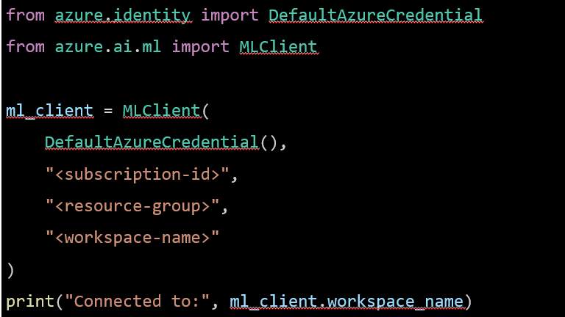
Getting Started with Python Scripts in Azure Machine Learning
azure-ai-ml = tells Python what to do in Azure ML
azure-identity = tells Python who you are so Azure lets you in

Slide 10
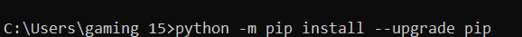
Getting Started with Python Scripts in Azure Machine Learning
In order to update your python:
Python –m pip install --upgrade pip

Slide 11
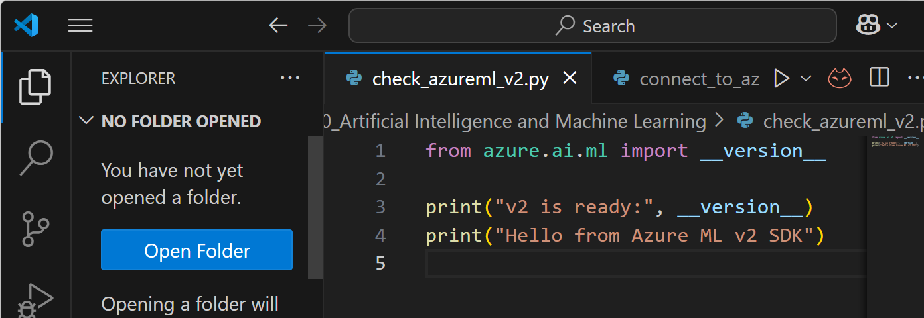
Getting Started with Python Scripts in Azure Machine Learning
Check if Azure ML v2 SDK is installed and working
The first part checks the installed version of the Azure ML v2 SDK and prints it.
The second part simply prints a welcome message so you know the Python file is running successfully.

Slide 12
Getting Started with Python Scripts in Azure Machine Learning
Check if Azure ML v2 SDK is installed and working
It confirms both:
The SDK is installed.
Python can execute code with no errors.

Slide 13
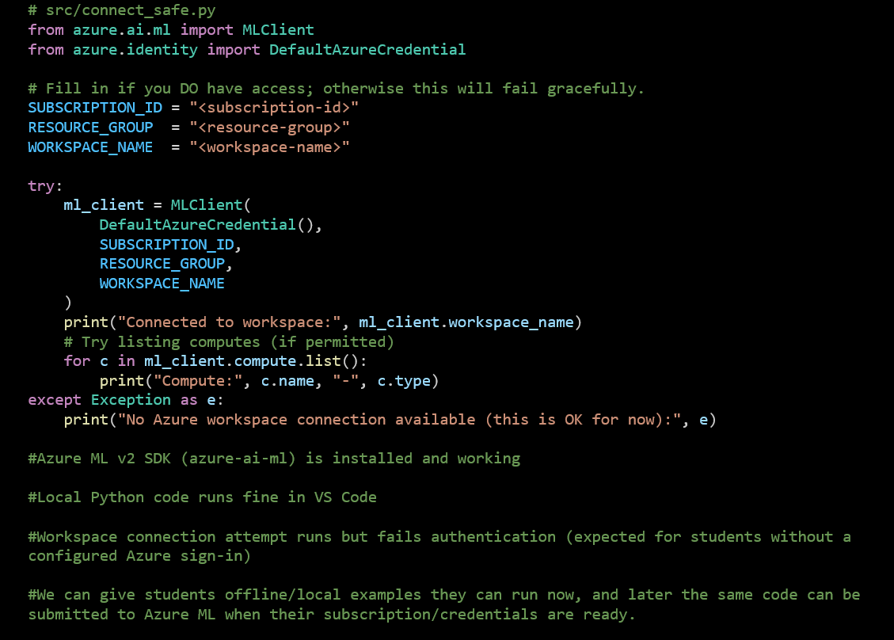
connect_workspace_safe python code
This code:
Tries to connect to an Azure Machine Learning workspace using your subscription, resource group, and workspace name.

Slide 14
connect_workspace_safe python code
If connection works: it prints the workspace name and lists available compute resources.

Slide 15
connect_workspace_safe python code
If connection fails: it shows a friendly error message instead of crashing.
Works fine offline — so students without Azure accounts can still run it and see the “safe fail” message.

Slide 16
connect_workspace_safe python code
It’s a safe test script to check if our Python environment can talk to Azure ML — without breaking if you’re not logged in yet.

Slide 17
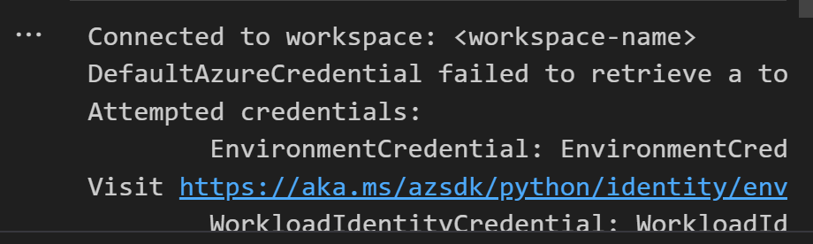
connect_workspace_safe python code

Slide 18
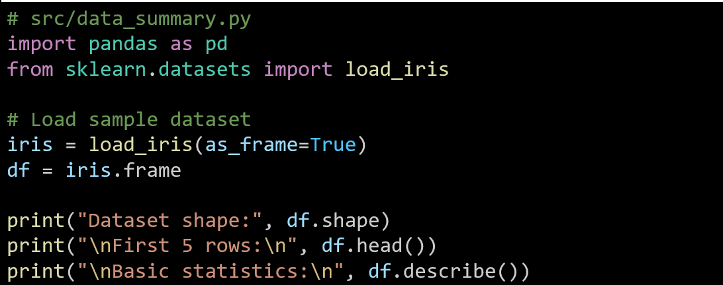
Data Description: Iris_data_summary python code

Slide 19
1. Data Description: Iris_data_summary python code
Dataset shape: (150, 5)
First 5 rows:
sepal length (cm) sepal width (cm) petal length (cm) petal width (cm) \
0 5.1 3.5 1.4 0.2
1 4.9 3.0 1.4 0.2
2 4.7 3.2 1.3 0.2
3 4.6 3.1 1.5 0.2
4 5.0 3.6 1.4 0.2
target
0 0
1 0
2 0
3 0
4 0
The dataset shape (150, 5) means there are 150 rows (samples) and 5 columns (4 features + 1 target label).
The statistics table shows basic descriptive measures (count, mean, standard deviation, min, quartiles, max) for each numeric column, summarising the distribution of feature values.

Slide 20
1. Data Description: Iris_data_summary python code
Basic statistics:
sepal length (cm) sepal width (cm) petal length (cm) \
count 150.000000 150.000000 150.000000
mean 5.843333 3.057333 3.758000
std 0.828066 0.435866 1.765298
min 4.300000 2.000000 1.000000
25% 5.100000 2.800000 1.600000
50% 5.800000 3.000000 4.350000
...
25% 0.300000 0.000000
50% 1.300000 1.000000
75% 1.800000 2.000000
max 2.500000 2.000000

Slide 21
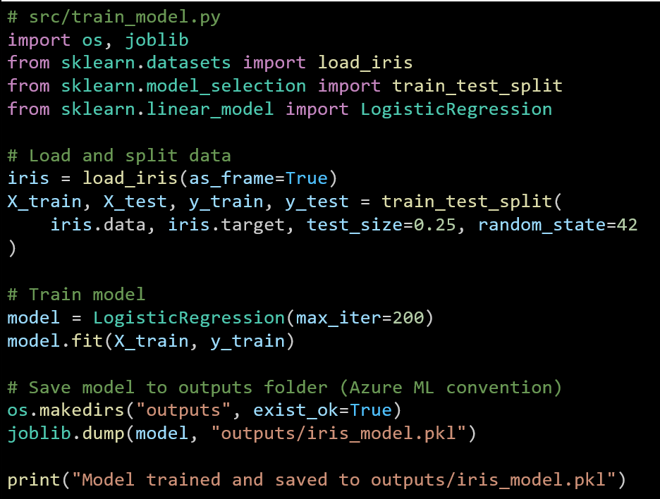
2. Train & Save a Model
This script loads the Iris dataset, splits it into training and test sets, and trains a logistic regression model. It then saves the trained model as a .pkl file in the outputs folder (Azure ML format). Finally, it prints a message confirming the model has been trained and saved.

Slide 22
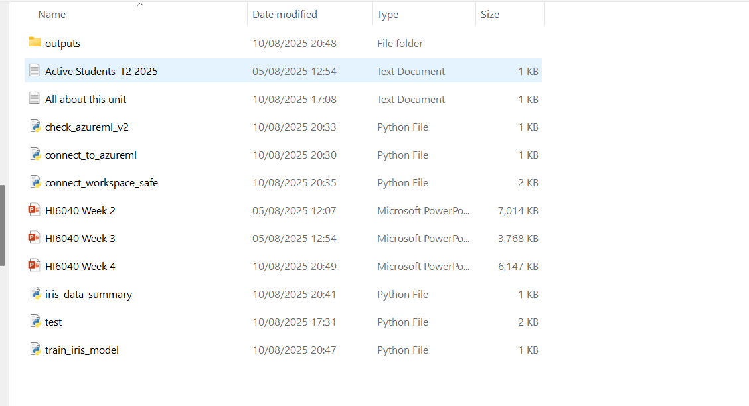
2. Train & Save a Model
If you ran it in Jupyter Notebook or Azure ML, the outputs folder will be relative to that environment’s working directory.

Slide 23
3. Load Model & Predict
# src/predict_model.py
import joblib
import pandas as pd
from sklearn.datasets import load_iris
# Load model
model = joblib.load("outputs/iris_model.pkl")
# Sample data (first 5 rows of iris dataset)
iris = load_iris(as_frame=True)
sample = iris.data.head()
# Predict
preds = model.predict(sample)
print("Sample data:\n", sample)
print("Predicted classes:", preds)
This script loads the previously trained Iris model from outputs/iris_model.pkl. It takes the first 5 rows of the Iris dataset as sample input. It then predicts the class for each sample and prints both the data and the predicted classes.

Slide 24
3. Load Model & Predict
Sample data:
sepal length (cm) sepal width (cm) petal length (cm) petal width (cm)
0 5.1 3.5 1.4 0.2
1 4.9 3.0 1.4 0.2
2 4.7 3.2 1.3 0.2
3 4.6 3.1 1.5 0.2
4 5.0 3.6 1.4 0.2
Predicted classes: [0 0 0 0 0]
The output shows the first 5 samples from the Iris dataset with their sepal and petal measurements. The model predicted all five samples as class 0, which corresponds to the setosa species. This means the trained model correctly identified them as the same flower type based on their measurements.

Slide 25
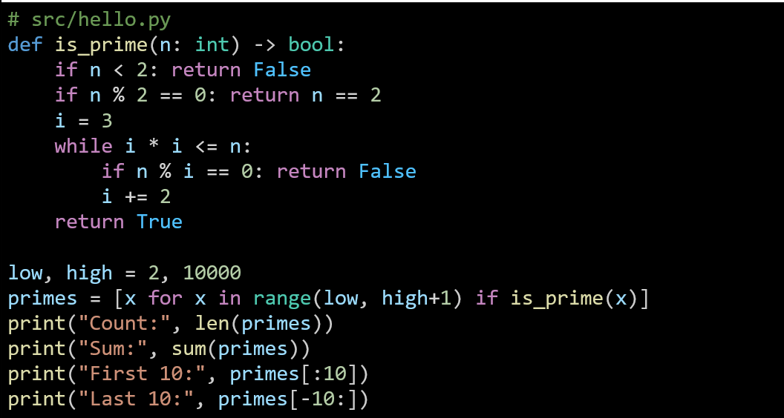
prime_number_finder.py code
Sum of primes in a range
This script checks numbers in a range to find all prime numbers, then prints their count, sum, and the first and last 10 primes.

Slide 26
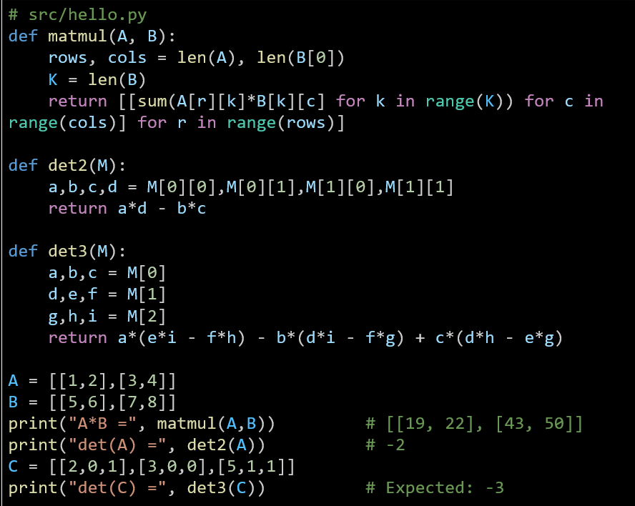
Matrix multiply + determinant (2×2 and 3×3)
This script performs basic matrix operations, including multiplication and calculating determinants for 2×2 and 3×3 matrices. It demonstrates these functions using example matrices and prints the results.

Slide 27
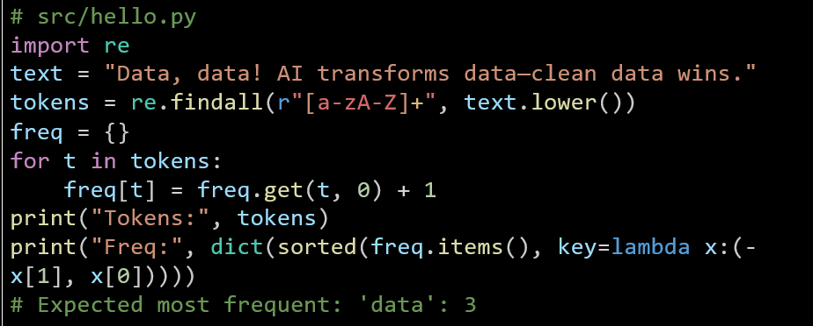
Word frequency (clean text)
This script extracts words from text using regex, converts them to lowercase, and counts how often each word appears. It then prints the list of tokens and the word frequencies sorted by highest count and then alphabetically.

Slide 28
student_scores_analysis
# src/hello.py
import pandas as pd
# create a tiny CSV
pd.DataFrame({
"student": ["Ana","Ben","Cara","Ana","Ben"],
"score": [78, 85, 92, 88, 73],
"week": [1,1,1,2,2]
}).to_csv("scores.csv", index=False)
# read + compute
df = pd.read_csv("scores.csv")
by_stu = df.groupby("student")["score"].mean().sort_values(ascending=False)
by_week = df.groupby("week")["score"].mean()
print("Average by student:\n", by_stu.to_dict()) # {'Cara': 92.0, 'Ana': 83.0, 'Ben': 79.0}
print("Average by week:\n", by_week.to_dict()) # {1: 85.0, 2: 80.5}
This script creates a small CSV of student scores, reads it with pandas, and calculates the average score per student and per week. The results are sorted and displayed as dictionaries.

Slide 29
Thank You
Need Help with coding? Send an email or ask during the tutorial session.
FKeivanian@my.holmes.edu.au

